Slide 1

Project Presentation
HEALTH BUDDY
Group no-27
Project Supervisor
Dr Chhaya Dalela
Group Members
Ananya Srivastava(1809131027)
Akhil kumar Singh(1809131018)
Ayushmaan Mani Tripathi(1809131056)
DEPARTMENT OF ELECTRONICS AND COMMUNICATION ENGINEERING

Slide 2
Problem Statement
Food is the main source of energy for the living beings thereby the food quality and safety has been in highest demand throughout the history.Also in this modern era people across the globe are becoming more interested in keeping a check on their weight, eating more healthy, and avoiding obesity hence a system that can measure calories and nutrition in everyday meals can be very useful.
The calorie content of many shop-bought foods is stated on the packaging as part of the nutrition label. But, While eating fruits and vegetables or in the process of cooking one is unsure of the calories which one is going to intake and the nutritional content of the food one is going to consume.Hence designing a system that could help in doing so.

Slide 3
Objectives
To detect any kind of staleness in the food by using methane, temperature and moisture sensor.
To detect objects (vegetables/fruits) using Image recognition,measuring their weight to determine the exact calorific values of each food item and creating a database for storage of each user data so that they can keep a check of daily, weekly, and monthly nutrition goals, notifying the user accordingly for the same.
** To provide additional information like recipe suggestions and meal plan suggestion based on the eating habits of the user.

Slide 4
Introduction
Food is the main source of energy for the living beings thereby the food quality and safety has been in highest demand throughout the history.
Also in this modern era people across the globe are becoming more interested in keeping a check on their weight, eating more healthy, and avoiding obesity hence a system that can measure calories and nutrition in everyday meals can be very useful.
We thereby propose a food calorie and nutrition measurement system integrated with food spoilage detection that can help people to measure and manage daily food intake.
The system is built on food image processing and uses nutritional fact tables along with IOT involved for detecting spoilage of food.
The system will autonomously measure the daily intakes of a person(s) with minimum user input and prepare a well maintained database of the data and will propose recommended meal plans.
The system will also notify the user in case of excess or less calorie intake daily.
The system will be able to suggest recipes based on the vegetables/fruits the user is planning to eat.

Slide 5
Literature Survey
S No | Paper | Work Done | Proposed Solution
1. | Food Recognition and Calorie Measurement using Image Processing and Convolutional Neural Network (IEEE 2020) | Fruits and vegetables are recognised using CNN algorithms with dataset from FooDD and Food101. The dataset is trained on RGB colour scheme rather done grayscaling the whole process for more efficient detection. | The proposed system will do the same analysis for multiple food at once to smooth out the process of food detection and make the system much more efficient. The proposed system will use a noiseless dataset for more efficient food recognition
2 | Raspberry Pi for Image Processing Education (IEEE 2017) | Setting up of raspberry pi and installing the necessary tools to implement Image Processing. Implementation of pre built classifiers to recognize faces. | The proposed system will use a combination of pre trained and self trained model for more precision
3. | An arduino sensor based approach for detecting the food spoilage(International Journal of Engineering Applied Sciences and Technology, 2020) | Fruits and vegetables can be stored and used for longer time as the period of freshness can be determined. The system reduces the commercial loss and increases commercial profit. | Precision will be improved by using better and more efficient sensors.

Slide 6
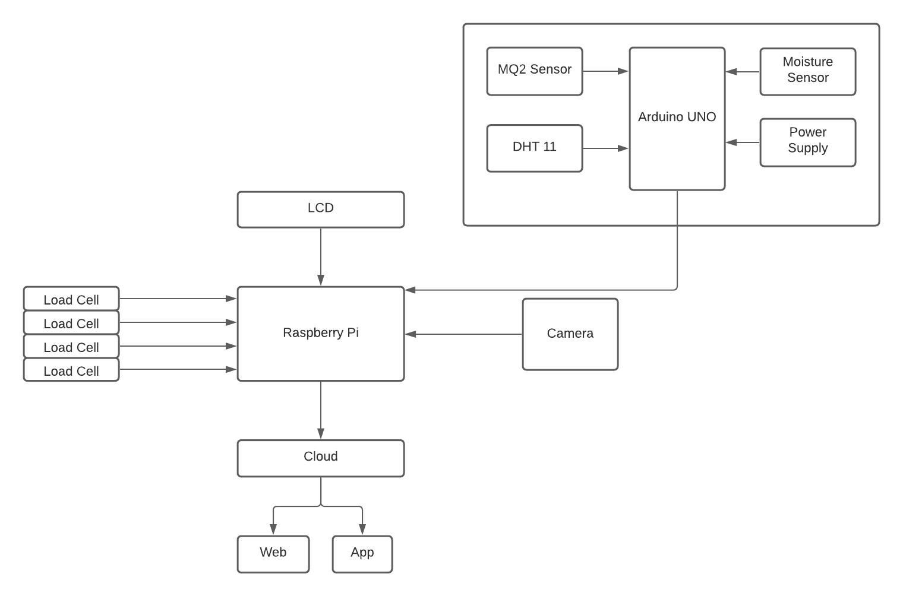
Block Diagram
FIGURE 1: BLOCK DIAGRAM OF PROPOSED SYSTEM

Slide 7
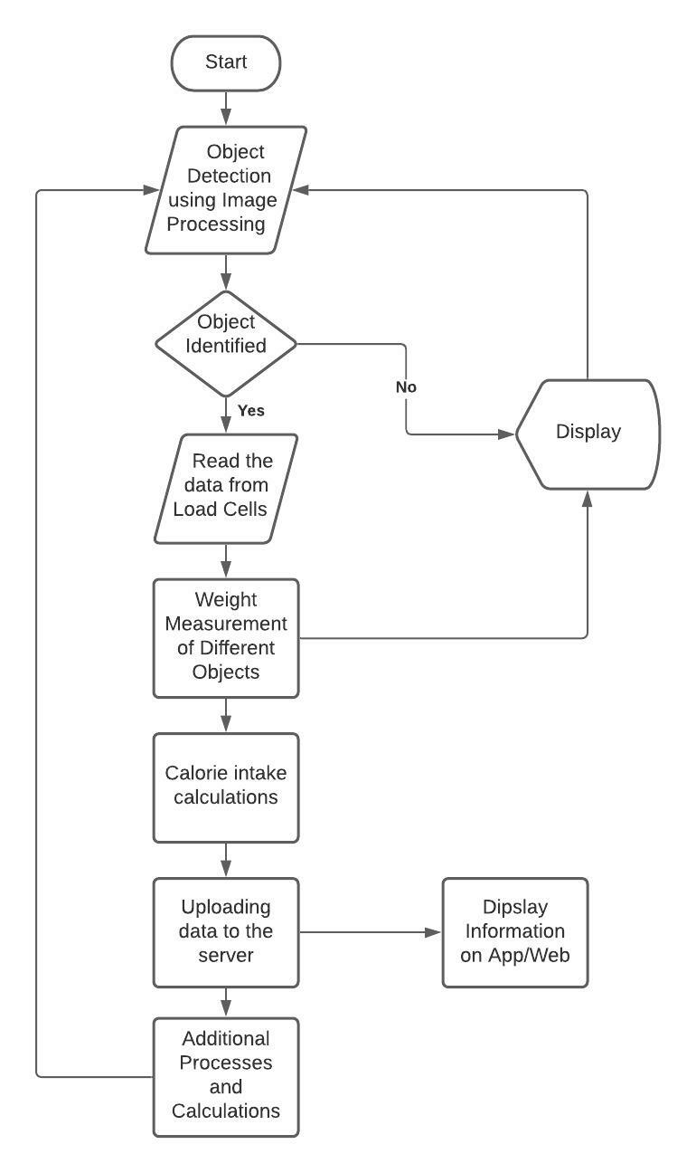
Flow Chart
FIGURE 2 FLOW CHART OF PROPOSED SYSTEM

Slide 8
Methodology
The system will consist of various sensors and components with the help of which the system will fulfill the proposed objectives.
The system will be enclosed in a box like structure, with Load Cells attached at the base of the box.
A camera connected to the Raspberry Pi will be placed on top of the box facing inside the box.
The contents of the box will be identified by Object Detection using Image Processing and the load cell at the base of the box will measure the weight of the objects (vegetables/fruits).
Multiple load cells will be used at the base of the box for measuring the individual weight of the objects.
The system will check for food spoilage in the vegetable(s)/fruit(s) placed inside the box.
The system will prepare a database of the calories and nutrient intake of the user and notify the user daily regarding the same.
The system will use the database to recommend meal plans for the user and also will suggest recipes based on the contents of the box in real time.
The system will be connected to Wifi and all the information can be accessed through the app/website.

Slide 9
Hardware/Software Tools Used
Hardware Used
Sensors (Moisture, Temperature, Methane)
Load Cell
Liquid Crystal Display (LCD)
Camera
Arduino
Raspberry Pi
Software Used
Python
Embedded C
Javascript
Node.js
Java
Android Studios

Slide 10
Work Done Since Last Presentation
Completion of the setup of Raspberry Pi with Rasbian OS.
Research about ML and its libraries .
Creation and Training of Vegetable Detection Model.
Integration of the model with a website..

Slide 11
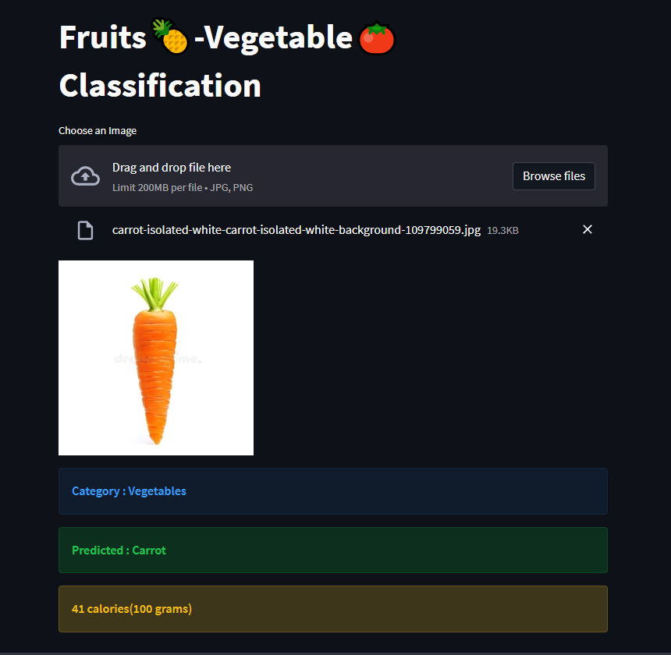
Vegetable Detection Model

Slide 12
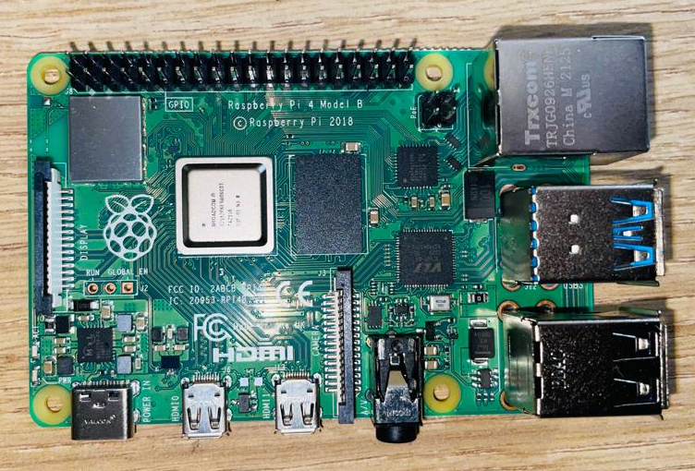
Raspberry Pi 4 Computer
Model B
The Raspberry Pi is a low cost, credit-card sized computer that plugs into a computer monitor. This has the ability to perform all the tasks a computer can.
We have taken a raspberry pi 4 because of its greater computational capabilities than its predecessors.

Slide 13
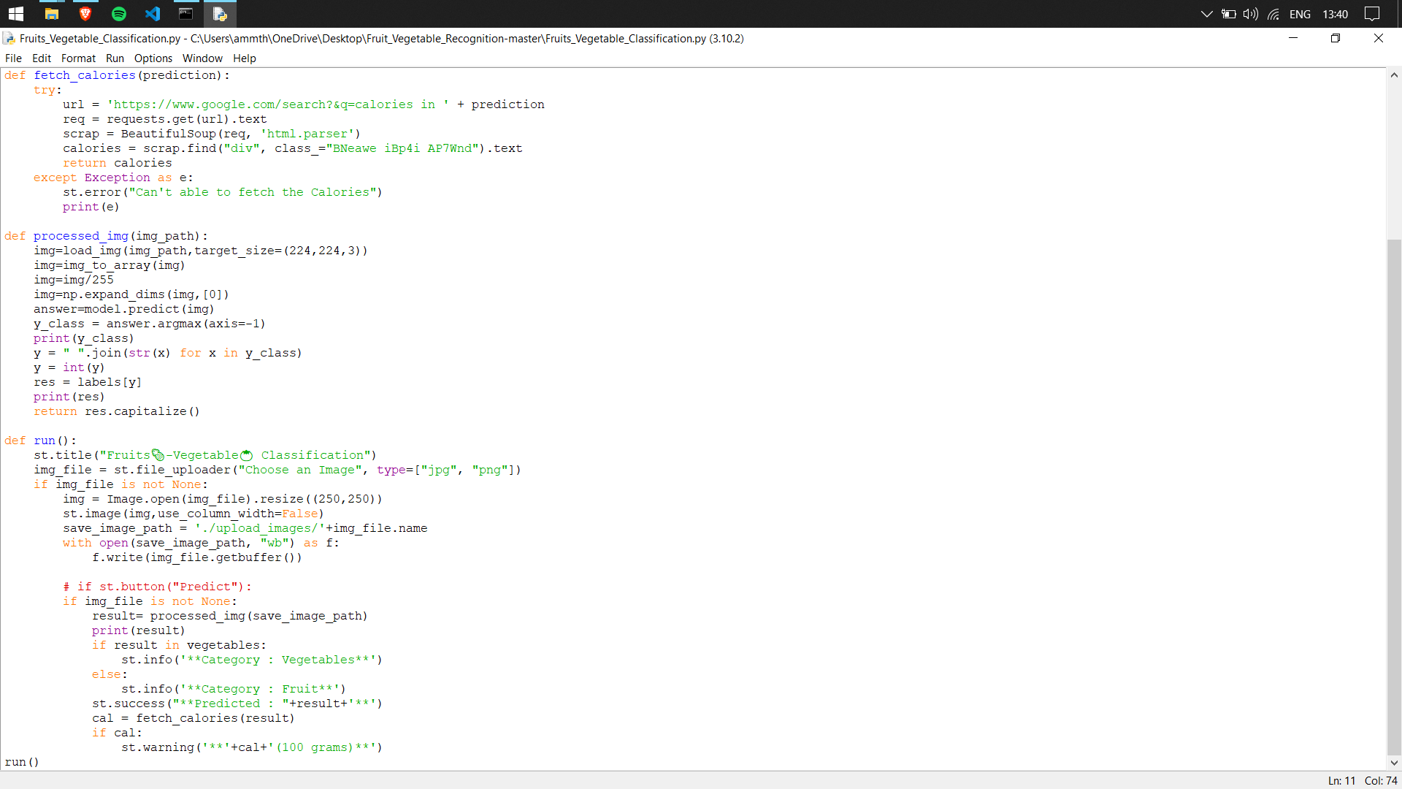
Website Code
We have used keras, numpy, request, streamlit, bs4 Libraries.

Slide 14
Expected work to complete before next presentation.
Configure and setup Pi cam.
Creation of Vegetable/Fruit detection model (Hardware).
Configuration and setup of load cells.

Slide 15
References
V. H. Reddy, S. Kumari, V. Muralidharan, K. Gigoo and B. S. Thakare, "Food Recognition and Calorie Measurement using Image Processing and Convolutional Neural Network," Fourth International Conference on Recent Trends on Electronics, Information, Communication & Technology (RTEICT-2019), pp. 109-115, DOI: 10.1109/RTEICT46194.2019.9016694.
G, Arun. (2020). AN ARDUINO SENSOR-BASED APPROACH FOR DETECTING THE FOOD SPOILAGE. International Journal of Engineering Applied Sciences and Technology. 5. 596-599. 10.33564/IJEAST.2020.v05i03.102.
J. Marot and S. Bourennane, "Raspberry Pi for image processing education," 2017 25th European Signal Processing Conference (EUSIPCO), 2017, pp. 2364-2366, doi: 10.23919/EUSIPCO.2017.8081633.

Slide 16
THANK YOU.

